Slide 1

CAPSTONE PROJECT ON :- PREDICTING THE NEWS POPULARITY ON MULTIPLE SOCIAL MEDIA PLATFORMS
BY:- ASHWANI BIST

Slide 2

CONTENT
1)THE PROBLEM STATEMENT
2)DATA DESCRIPTION
3)THE EDA
3)PREPARING DATA SET
4)CONCLUSION
5)CHALLENGES
THE PRO

Slide 3
PROBLEM DESCRIPTION
* With the advancement in technology, news organizations have begun to rely more on online social platforms and media analytics as a way to attract readers. So, for news publishing sources, it’s become very important to know which kind of news articles will appeal more to the readers.
* In this project, firstly we have a news dataset which contains around 100000 news items published on three social media platforms: Facebook, Google Plus and LinkedIn, between November 2015 to July 2016 on four topics: Obama, Economy, Palestine, Microsoft. And we also have 12 social feedback dataset which contains the popularity level of news items incremental time slices of 20 min after publication.

Slide 4
Data DESCRIPTION
IDLink (numeric): Unique identifier of news items
Title (string): Title of the news item according to the official media sources
Headline (string): Headline of the news item according to the official media sources
Source (string): Original news outlet that published the news item
Topic (string): Query topic used to obtain the items in the official media sources
PublishDate (timestamp): Date and time of the news items' publication
SentimentTitle (numeric): Sentiment score of the text in the news items' title
SentimentHeadline (numeric): Sentiment score of the text in the news items' headline
Facebook (numeric): Final value of the news items' popularity according to the social media source Facebook
GooglePlus (numeric): Final value of the news items' popularity according to the social media source Google+
LinkedIn (numeric): Final value of the news items' popularity according to the social media source LinkedIn

Slide 5
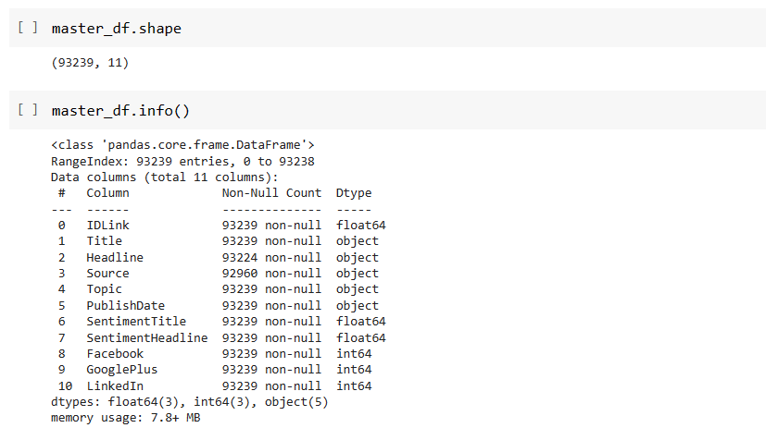
DATA SET DESCRIPTION
There are 93239 number of rows present in the data set.
There are 11 number of columns present in the data set.

Slide 6
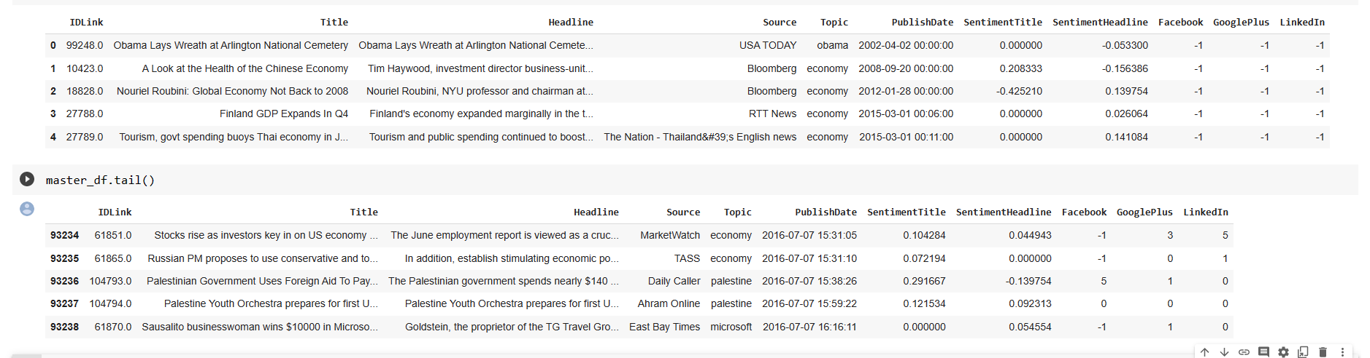
Overview of the data
Title and Headline columns contain textual data. We would require to use TfidfVectorizer or CountVectorizer to deal with them.
Topic is the categorical column.
Source and Headline column contains some null values.

Slide 7
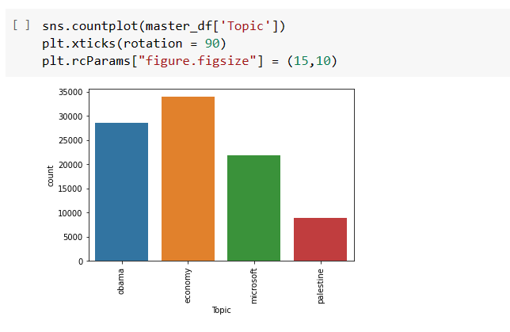
MOST NEWS FOLLOWED
We have most news on economy followed by Obama

Slide 8
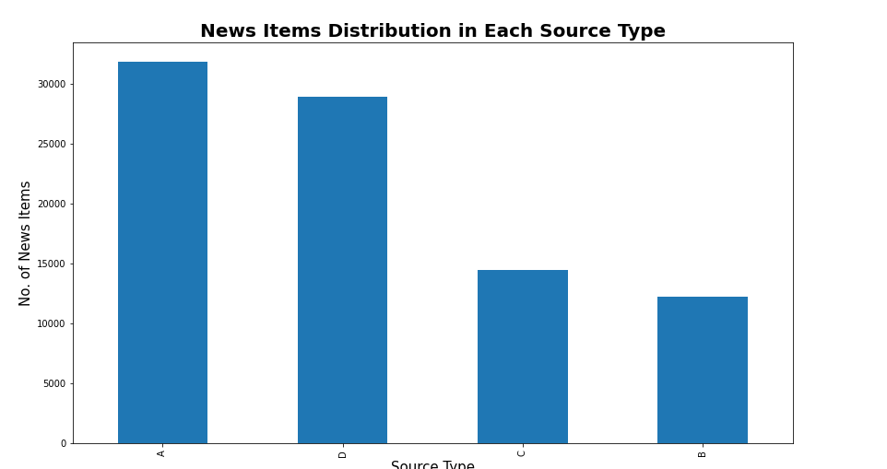
News Items Distribution
The plot clearly shows the distribution of news items published by each category of sources.
Source A has published the highest, and Source B published the lowest number of news items respectively

Slide 9
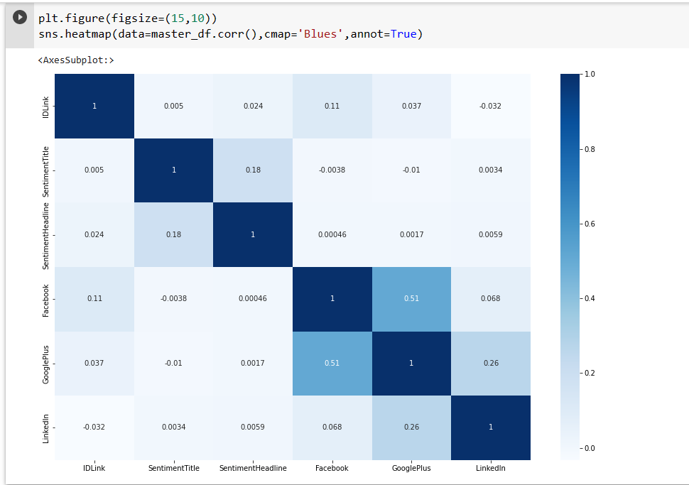
HEAT MAP OF OUR DATA SET
Sentiment Title and sentiment Headline are not tightly correlated which mean we could add them both for our regression task.
Here no column correlated to each other which means we have nothing to worry about multi collinearity.

Slide 10
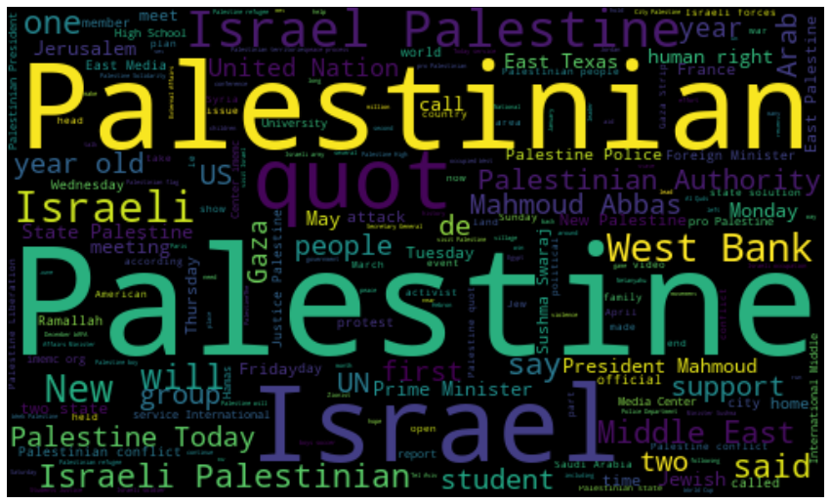
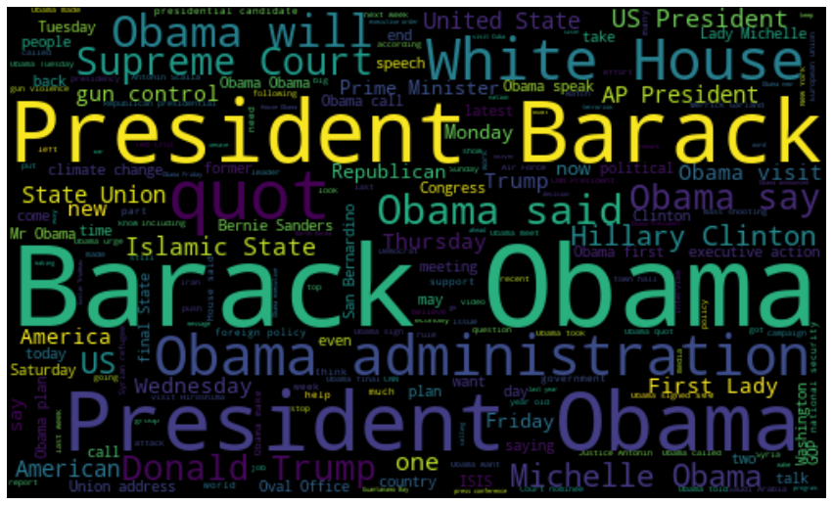
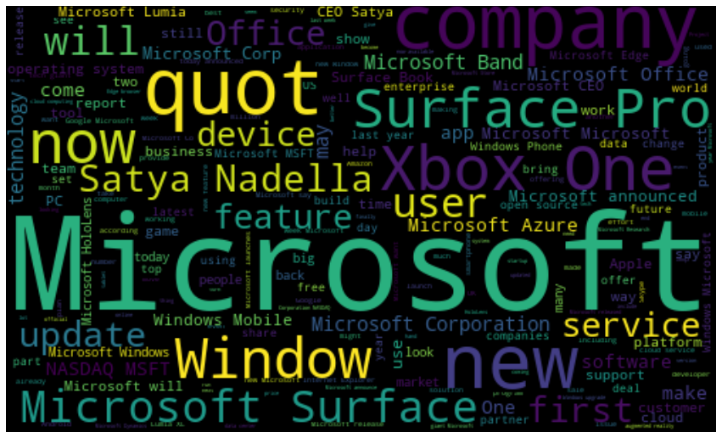
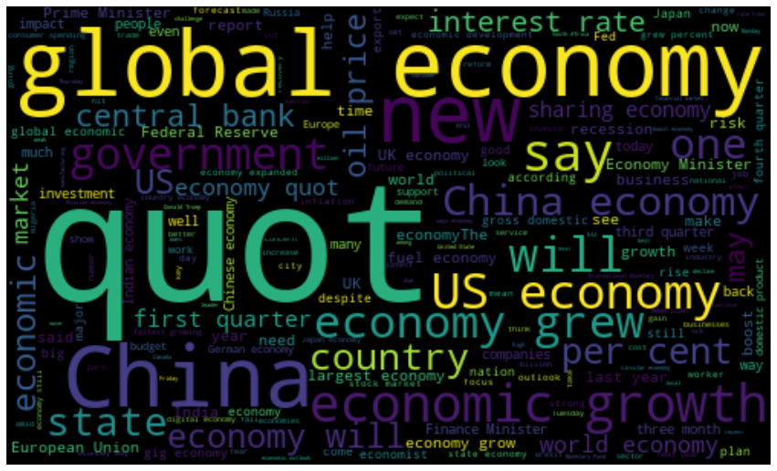
WORD CLOUD BASED ON TOPIC
Obama
Palestine
Microsoft
Economy

Slide 11
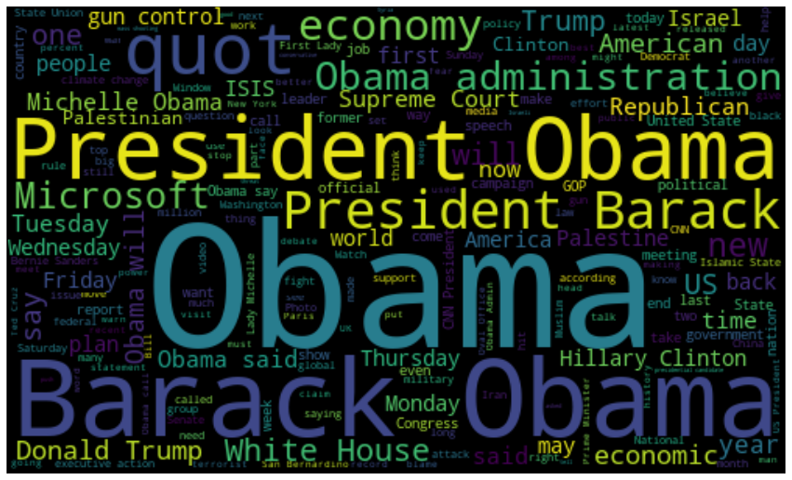
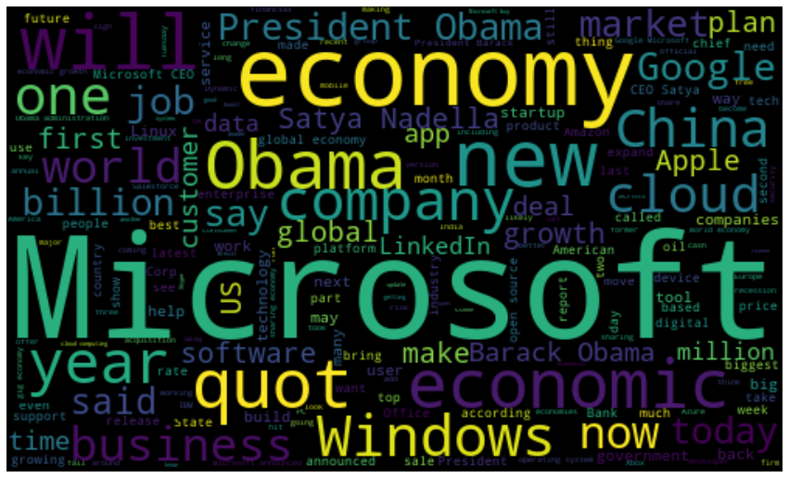
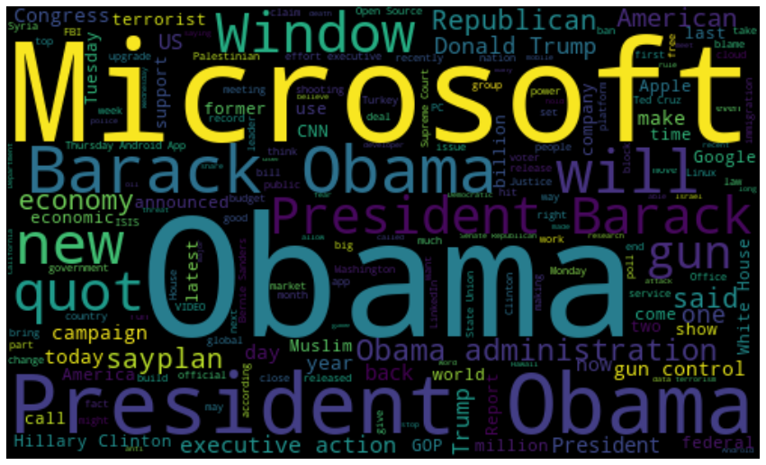
WORD CLOUD BASED ON SOCIAL MEDIA
FB
Social
Media
LI
GP
News With 100+ likes On Social Media

Slide 12
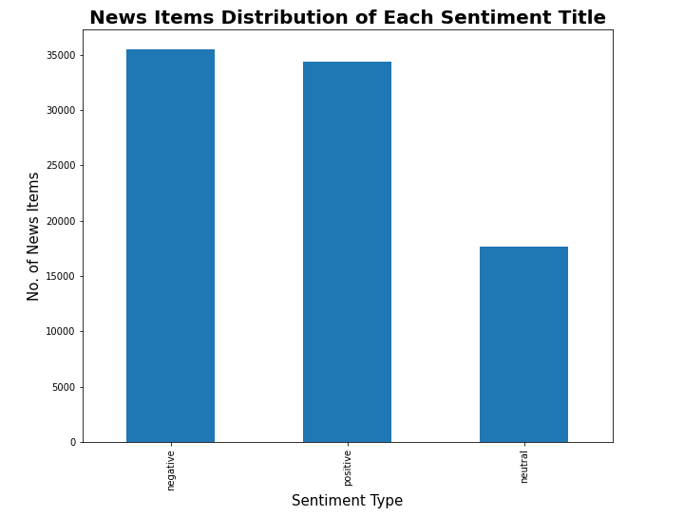
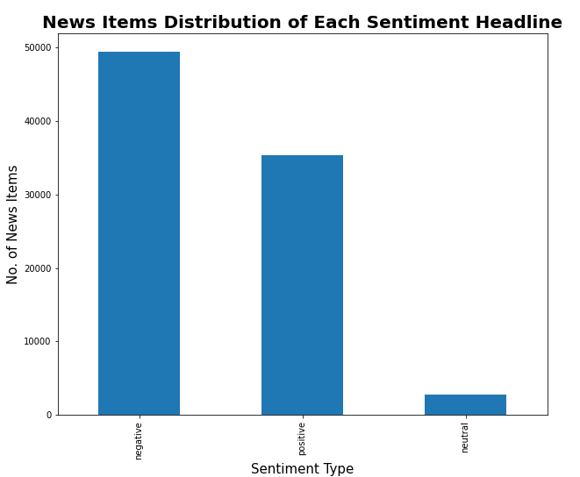
Sentiment Headline and Sentiment Title
The two graphs depicts the count of news items falling in each sentiment category.
We can clearly see that the neutral news items are less as compared to positive and negative news.
We can also conclude that the number of negative sentiment news are higher as compared to positive ones.

Slide 13
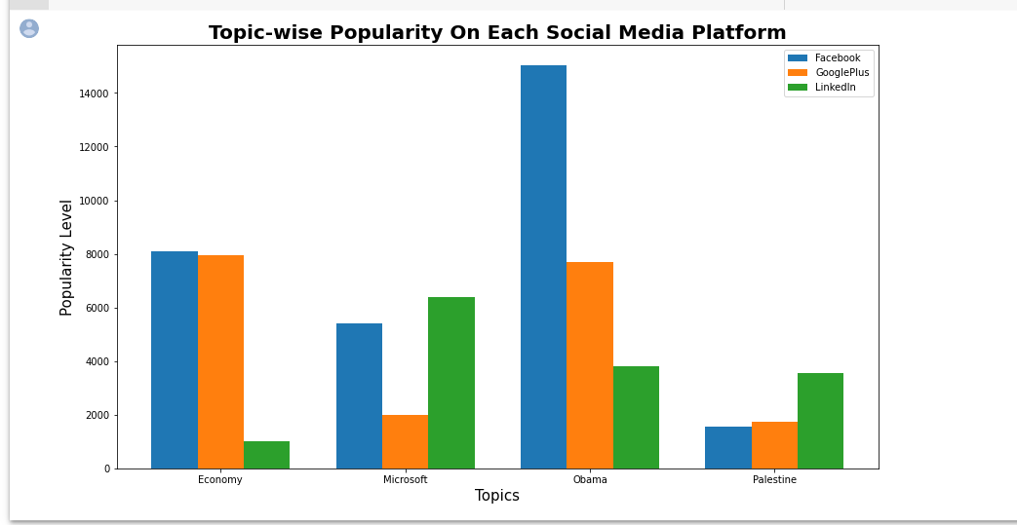
Popularity Comparison for Social Media Platforms
News item related to Obama are much more popular on Facebook as compared to other platforms.
Popularity level of Economy related news items and Obama related news items is approximately equal on Google Plus.
Popularity level of Economy news is same on both Facebook and Google Plus.
On LinkedIn, Microsoft related news gains higher popularity compared to others.
On LinkedIn, popularity of Economy news items is very less.

Slide 14
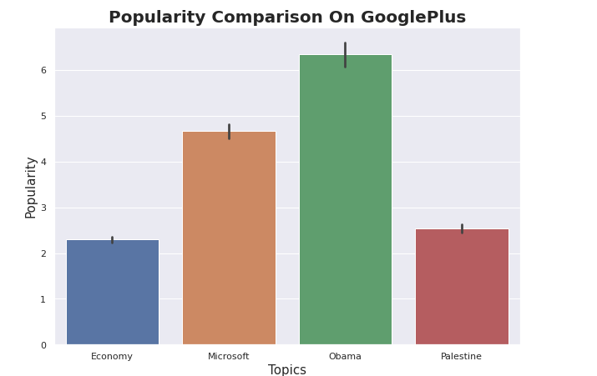
POPULARITY COMPARISON ON GOOGLE PLUS
* Supposedly the platform is Google Plus, then we can say that the popularity trend of Economy is always below the popularity level of other topics over the time period.
* Similarly, popularity of Obama news increases substantially over the period of time.

Slide 15
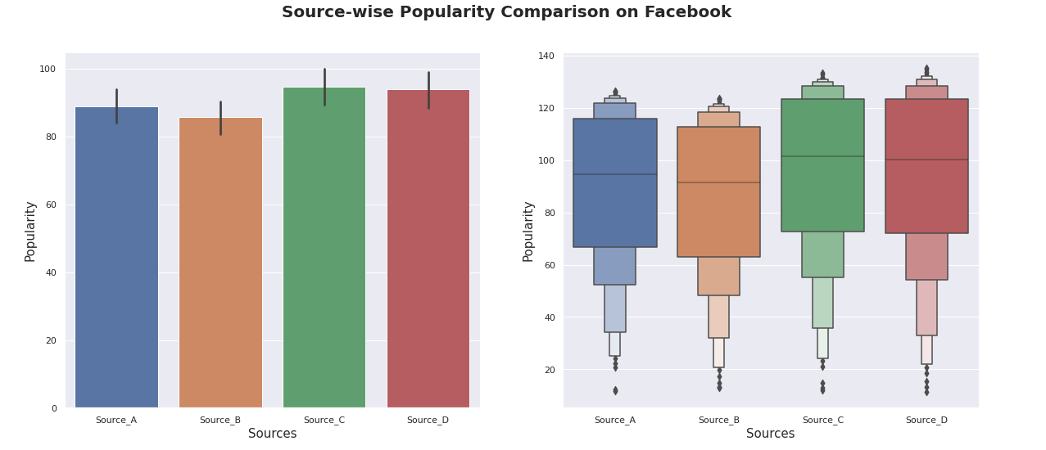
SOURCE WISE POPULARTIY COMPARISON
We can see the different popularity trend line of sources on a selected platform.
From Boxen Plots, we can see the range in which popularity lies for news items on a particular platform and their outliers.
Bar graph compares the popularity of different sources on a selected platform

Slide 16
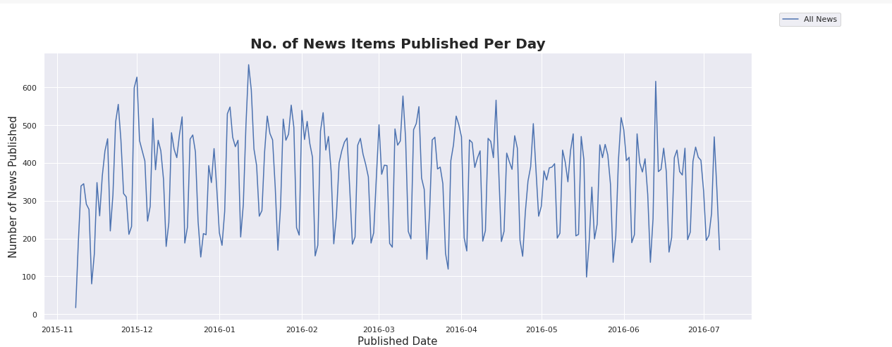
News Publications Per Day
From the above plot, we can conclude that the number of news published over the period of 8 months is evenly distributed.

Slide 17
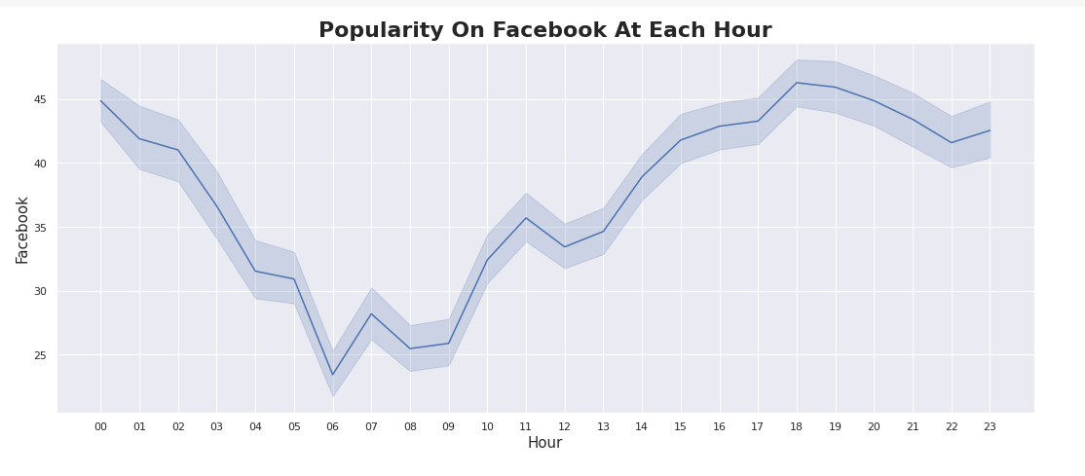
POPULARITY ON FACEBOOK AT EACH HOUR
We can conclude that the popularity of almost every news item rises from 14:00 till mid-night.
And drastically decreases thereafter.

Slide 18
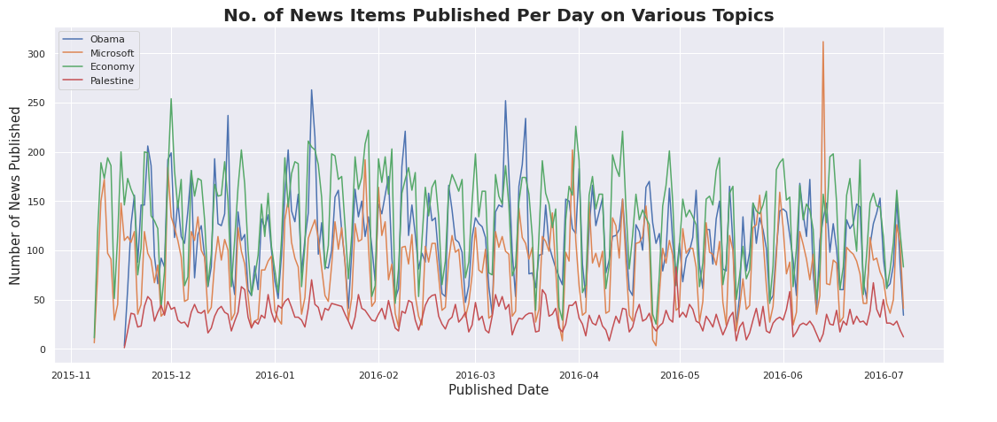
News Published Per Day On Various Topics
From the above graph, we can conclude that number of news items published of Palestine is less as compared to other news items belonging to other topics

Slide 19
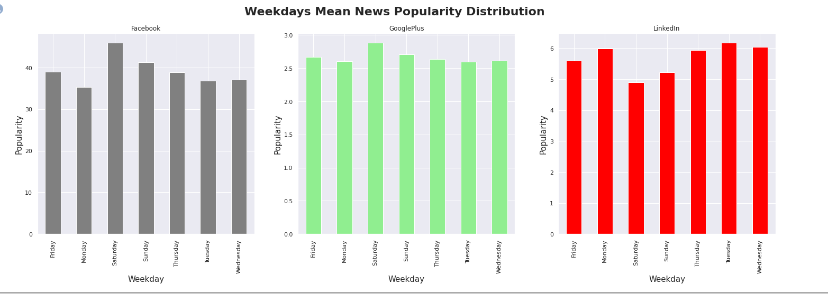
Popularity Based on Published Weekday
Saturdays are good for Facebook and Google Plus but bad for LinkedIn in terms of popularity.
Mondays are good for LinkedIn but bad for Facebook.

Slide 20
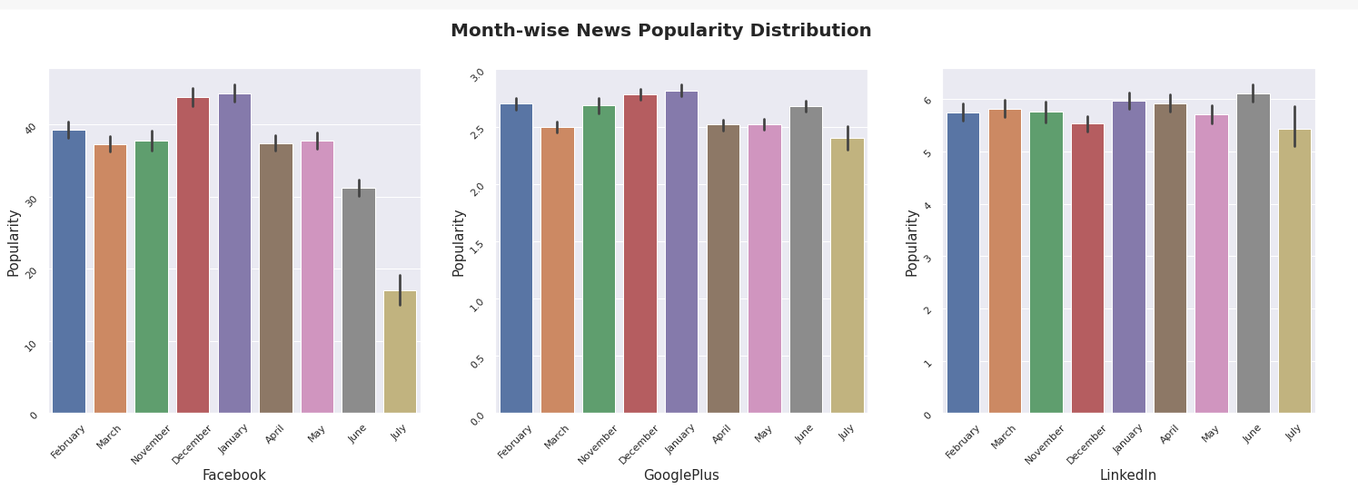
Month-wise News Popularity Distribution
From the above graph we can depict that the popularity level of news items in July is quite less on Facebook compared to the other platforms.
There is not much difference in popularity levels of Google Plus and LinkedIn in 8 months.

Slide 21
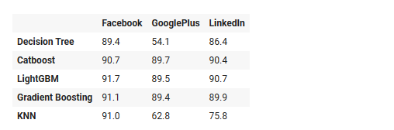
Final output of different models for different Dependent Variable

Slide 22
CONCLUSION
Starting from loading our dataset, we initially performed data cleaning and refactoring. Before data processing, we applied feature scaling techniques to standardize our data to bring all features on the same scale and make it easier to process by ML algorithms.
Through Exploratory Data Analysis, we observed that on weekends the number of news items published gradually decreases. News Items related to the topic of Obama gain higher popularity on Facebook. And, Economy news gains equal popularity on Google Plus and Facebook whereas Microsoft-related news items gain higher popularity on LinkedIn. We observed that the number of news items related to Palestine is comparatively less. We also observed that news Items published at midnight gain less popularity.
Through Feature selection, we were able to compare the Gini importance of features and using a correlation matrix we were able to find the correlation between independent and dependent features
Further, we applied Machine Learning algorithms for predicting news popularity. For the Decision Tree Regressor algorithm, we got the R2 score as 85% and after hyperparameter tuning, the R2 score increased to 88%. Similarly for Catboost, LightGBM, Gradient Boosting Regressor and KNN we obtained an R2 score of around 92%. Finally for obtaining feature importance we applied the SHAP algorithm.
So, the best model score obtained from our prediction modeling is 92% and the most impacting features are popularity level in time slices variables.

Slide 23

Challenges
*We have 3 dependent variables(Facebook, Google Plus, LinkedIn)
*We have a huge data set (it consists of 12 dataset which contain
the information of likes of each topic on the given social media
platform.)
*To implement TF-IDF vectorizer on corpus
of having 100000 news document.
*Google Collab Crash problem.

Slide 24

THANK YOU

